Slide 1
Spine Disorders: Low Back and Neck Pain
Presented by:
James E. Eubanks, MD, DC, MS
Resident Physician, Dept. of Physical Medicine and Rehabilitation
University of Pittsburgh Medical Center (UPMC)
Notes:
Hello! This is Jim Eubanks, and I am a resident physician in the department of physical medicine and rehabilitation at the University of Pittsburgh Medical Center (UPMC). It is my pleasure to present the topic of Spine Disorders: Low Back and Neck Pain from the United States Bone and Joint Initiative (USBJI)’s Burden of Musculoskeletal Diseases (BMUS) in the United States.

Slide 2
The Burden of Musculoskeletal Diseases in the United States: Prevalence, Societal and Economic Costs (BMUS), 4th edition, is produced by the United States Bone and Joint Initiative (USBJI).
BMUS 4th Edition
www.boneandjointburden.org
Notes:
The material in this video comes from BMUS 4th Edition.

Slide 3
Fast Facts: Low Back and Neck Pain
Notes:
First, we are going to cover some ”fast facts” about low back and neck pain. Roughly 1 in 3 adults experience some degree of persistent low back pain, and around $315 billion is lost annually in the US because of treatment costs and lost wages.
Back and neck pain include many common conditions as listed here. Notably, 72% of low back pain medical visits are those from prime working age adults. There are an estimated 10.9 million persons in the US experiencing limitations in their daily activities because of back pain. It is thought that most spine-related pain is associated with the aging process, and as we will see during this video, most of the time there is a lot patients can do to get back to doing what matters to them in life. Nonetheless, the experience of pain and its affect on a given individual varies greatly due to many factors, and much of the time we do not know a specific cause for spine-related pain.
In terms of the economic impact, annual hospital costs total around $156 billion, annual lost workdays due to spine-related pain amounted to 264 million days, and the loss of earnings annually is around $4.6 billion.

Slide 4
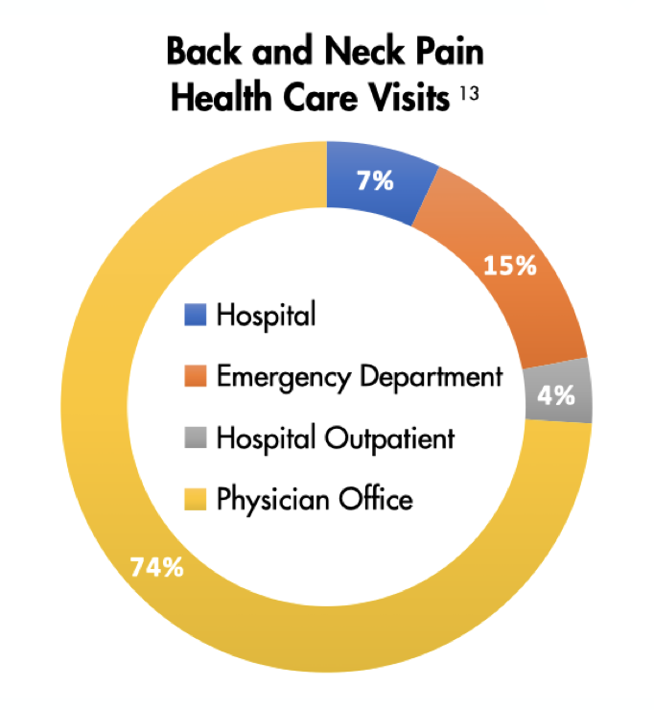
Fast Facts: Low Back and Neck Pain
Notes:
Here we can see the visit settings where persons with back and neck pain tend to present in the US. Importantly, those who experience spine-related pain cover a broad range of age groups as evident here.

Slide 5
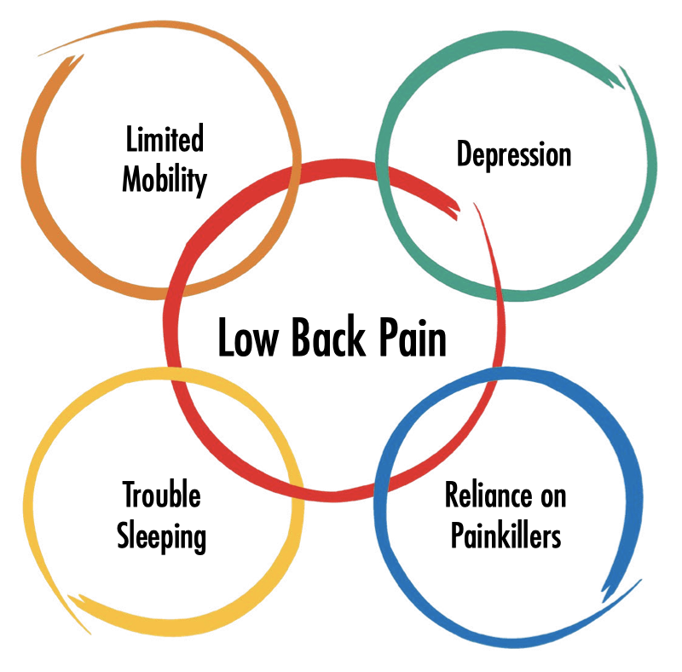
The Hidden Impact of Low Back Pain on Americans
Every day, tens of thousands of Americans visit physician offices, emergency departments, and outpatient clinics seeking relief from low back pain (LBP).
LBP is a common condition that is influenced by many factors. Important side effects include limited mobility, depression, trouble sleeping, and reliance on painkillers.

Slide 6
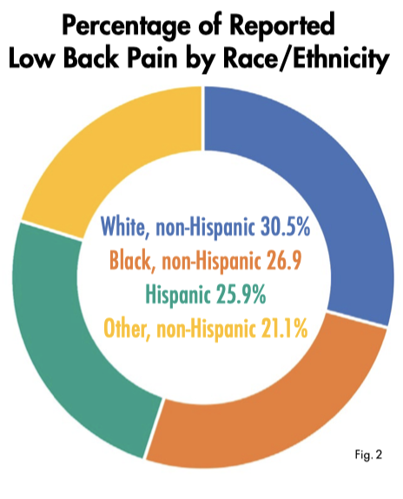
The Hidden Impact of Low Back Pain on Americans
LBP is one of the most reported conditions in Americans over the age of 18.
It affects more than 1 in 4 adults of all races/ethnicities across every region of the country.
Most cases do not require interventional care or hospitalization, and often conservative methods like outpatient clinic visits, physical therapy, and medications are sufficient. When hospitalization is necessary, charges are higher, on average, than those of other hospital stays.

Slide 7
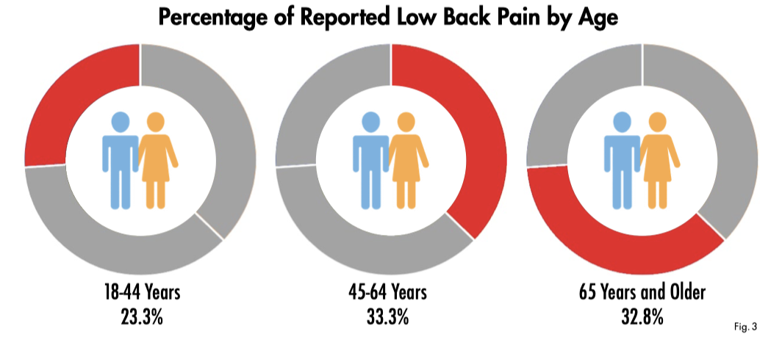
The Hidden Impact of Low Back Pain on Americans
Notes:
Low back pain is a leading cause of disability in the US—and globally. This is nearly 2 lost workdays for every full-time employee in the workforce.
Note that low back pain accounts for nearly 30% of the commonly reported medical conditions in adults, with neck pain coming in at 15%. In total, musculoskeletal conditions comprise roughly 50% of the common conditions experienced by adults, but unfortunately, our public health efforts and research funding does not match this disease burden, which is a major reason for the BMUS project here at USBJI.

Slide 8
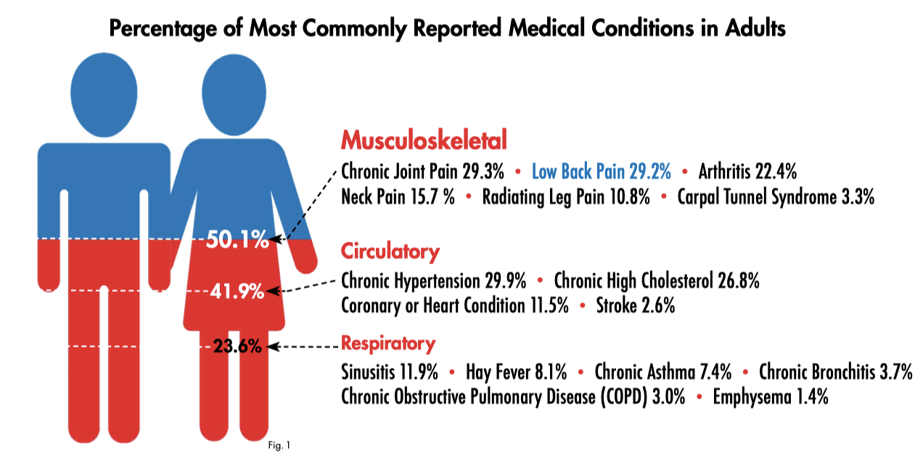
The Hidden Impact of Low Back Pain on Americans
Notes:
Low back pain is a leading cause of disability in the US—and globally. This is nearly 2 lost workdays for every full-time employee in the workforce.
Note that low back pain accounts for nearly 30% of the commonly reported medical conditions in adults, with neck pain coming in at 15%. In total, musculoskeletal conditions comprise roughly 50% of the common conditions experienced by adults, but unfortunately, our public health efforts and research funding does not match this disease burden, which is a major reason for the BMUS project here at USBJI.

Slide 9
Reducing the Burden through Research and Education
Despite its prevalence and impact, LBP receives far less research funding than other condition. Increased funding is needed to better understand LBP, compare the effectiveness of treatment alternatives, develop new treatments, and evaluate prevention strategies.
Notably, research has already led to new knowledge that is not always implemented in clinical practice. Some effective therapies for LBP have little or no cost, such as self-management strategies and exercise-based approaches.
Greater investments in education that address knowledge gaps such as these can help get patients back to work and performing their daily activities quicker and with less expense.
Notes:
Advances in prevention and treatment of LBP are possible, but they can only occur with adequate funding and within a health system organized to deliver care effectively.

Slide 10
Selected References
Zaina F, Tomkins-Lane C, Carragee E, Negrini S. Surgical versus non-surgical treatment for lumbar spinal stenosis. Cochrane Database Syst Rev. 2016(1):CD010264.
Ammendolia C, Stuber KJ, Rok E, et al. Nonoperative treatment for lumbar spinal stenosis with neurogenic claudication. Cochrane Database Syst Rev. 2013(8):CD010712.
Chao R, Qaseem A, Snow V, et al. Diagnosis and treatment of low back pain: A joint clinical practice guideline from the American College of Physicians and the American Pain Society Ann Intern Med. 2007;147(7):478-491.
Taylor P, Pezzullo L, Grant SJ, Bensoussan A. Cost-effectiveness of acupuncture for chronic nonspecific low back pain. Pain Pract. 2014;14(7):599-606.
Notes:
Advances in prevention and treatment of LBP are possible, but they can only occur with adequate funding and within a health system organized to deliver care effectively.

Slide 11
USBJI
The United States Bone and Joint Initiative (USBJI) is a multi-disciplinary initiative that advocates for, and promotes, multidisciplinary, coordinated, patient-centered care to improve the prevention, diagnosis, and treatment of musculoskeletal conditions.
Four primary values
Raising awareness and educating the world on the growing impact of MSK pathology
Empowering patients to participate in the decision-making process of their care and treatment
Increasing global funding for prevention activities and treatment research
Seek and promote cost-effective prevention and treatment of MSK injuries and disorders
Notes:
*SAY AFTER FIRST BULLET POINT: The USBJI is the US arm of the Global Alliance for Musculoskeletal Health (G-MUSC)—previously the Bone and Joint Decade—which is endorsed by 63 national governments and more than 750 patient advocacy and health professional organizations.

Slide 12
Low Back and Neck Pain Chapter Authors
Lead Author(s):
Kern Singh, MD
Gunnar B. J. Andersson, MD, PhD
Supporting Author(s):
Sylvia I. Watkins-Castillo, PhD

Slide 13
USBJI BMUS 4th Edition MedEd Team
James E. Eubanks, MD, DC, MS – University of Pittsburgh Medical Center (UPMC)
Laurenie Louissaint, MD, MSc – Mount Sinai Health System
Michael E. Farrell, MD, DC – Medstar Georgetown University/NRH
Kuntal Chowdhary, MD – University of Pittsburgh Medical Center (UPMC)
Vinny Francio, MD, DC, MS – University of Kansas Medical Center
Sara Dykowski, MD – University of Michigan Medical Center
Adedeji Olusanya, DO, MPH – UT Health San Antonio

Slide 14
www.boneandjointburden.org

