Slide 1
MSK Matters: The Current State of Musculoskeletal Disorders in the United States
James E. Eubanks, Jr., MD, MS
Resident Physician, Dept. of Physical Medicine and Rehabilitation
University of Pittsburgh Medical Center (UPMC)
Michael E. Farrell, II, MD
Resident Physician, Dept. of Physical Medicine and Rehabilitation
National Rehabilitation Hospital (NRH)
Brandon Barndt, OMS-IV
Medical Student, Philadelphia College of Osteopathic Medicine
www.physiatrynow.org

Slide 2
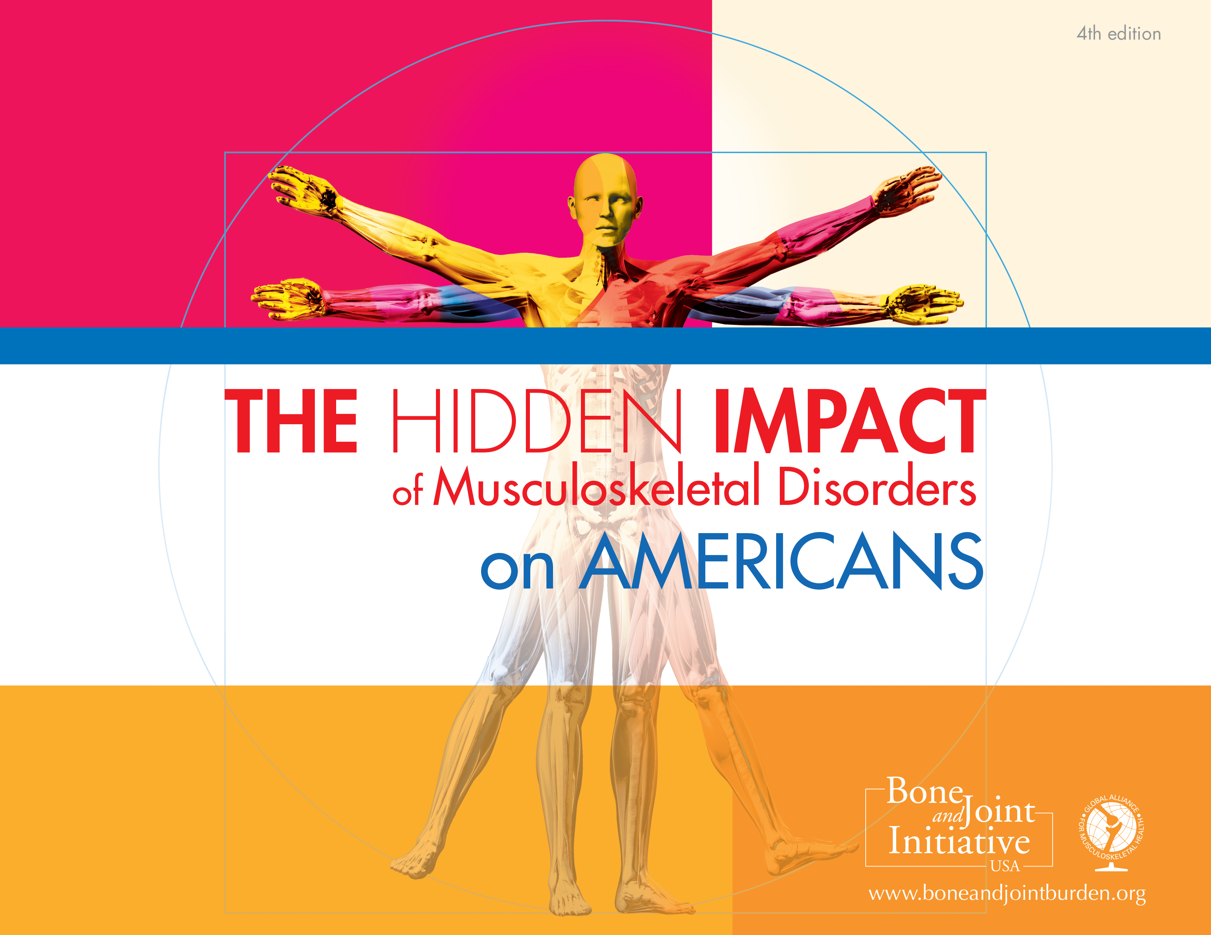
The Burden of Musculoskeletal Diseases in the United States
Musculoskeletal (MSK) disorders are the second most common reason patients seek care in primary care clinics.
18% of clinical visits led to an MSK Dx
MSK disorders affect more than 1 out of 2 persons in the United States aged 18 and over, and nearly 3 out of 4 of those aged 65 and over.
The majority (>50%) of disabling conditions are due to MSK disorders.
EXPENSIVE, too:
In 2011, 5.7% of the US GDP went to costs associated with MSK Dx
In 2012, 216 million work-days were lost due to MSK Dx
Sources:
http://www.boneandjointburden.org

Slide 3
The Burden of Musculoskeletal Diseases in the United States cont.
Persons with chronic MSK pain often have comorbidities, which may include depression, anxiety, diabetes, hypertension, etc.
Even partners of those with MSK pain have a higher chance of having pain themselves
With the aging of the US population, MSK disorders are becoming a greater burden on individuals and communities every year…
Sources:
Campbell P, Shraim M, Jordan K, Dunn K (2015). In sickness and in health: a cross-sectional analysis of concordance for musculoskeletal consultations in 13,507 couples. (early view: European Journal of Pain doi:10.1002/ejp.744)

Slide 4
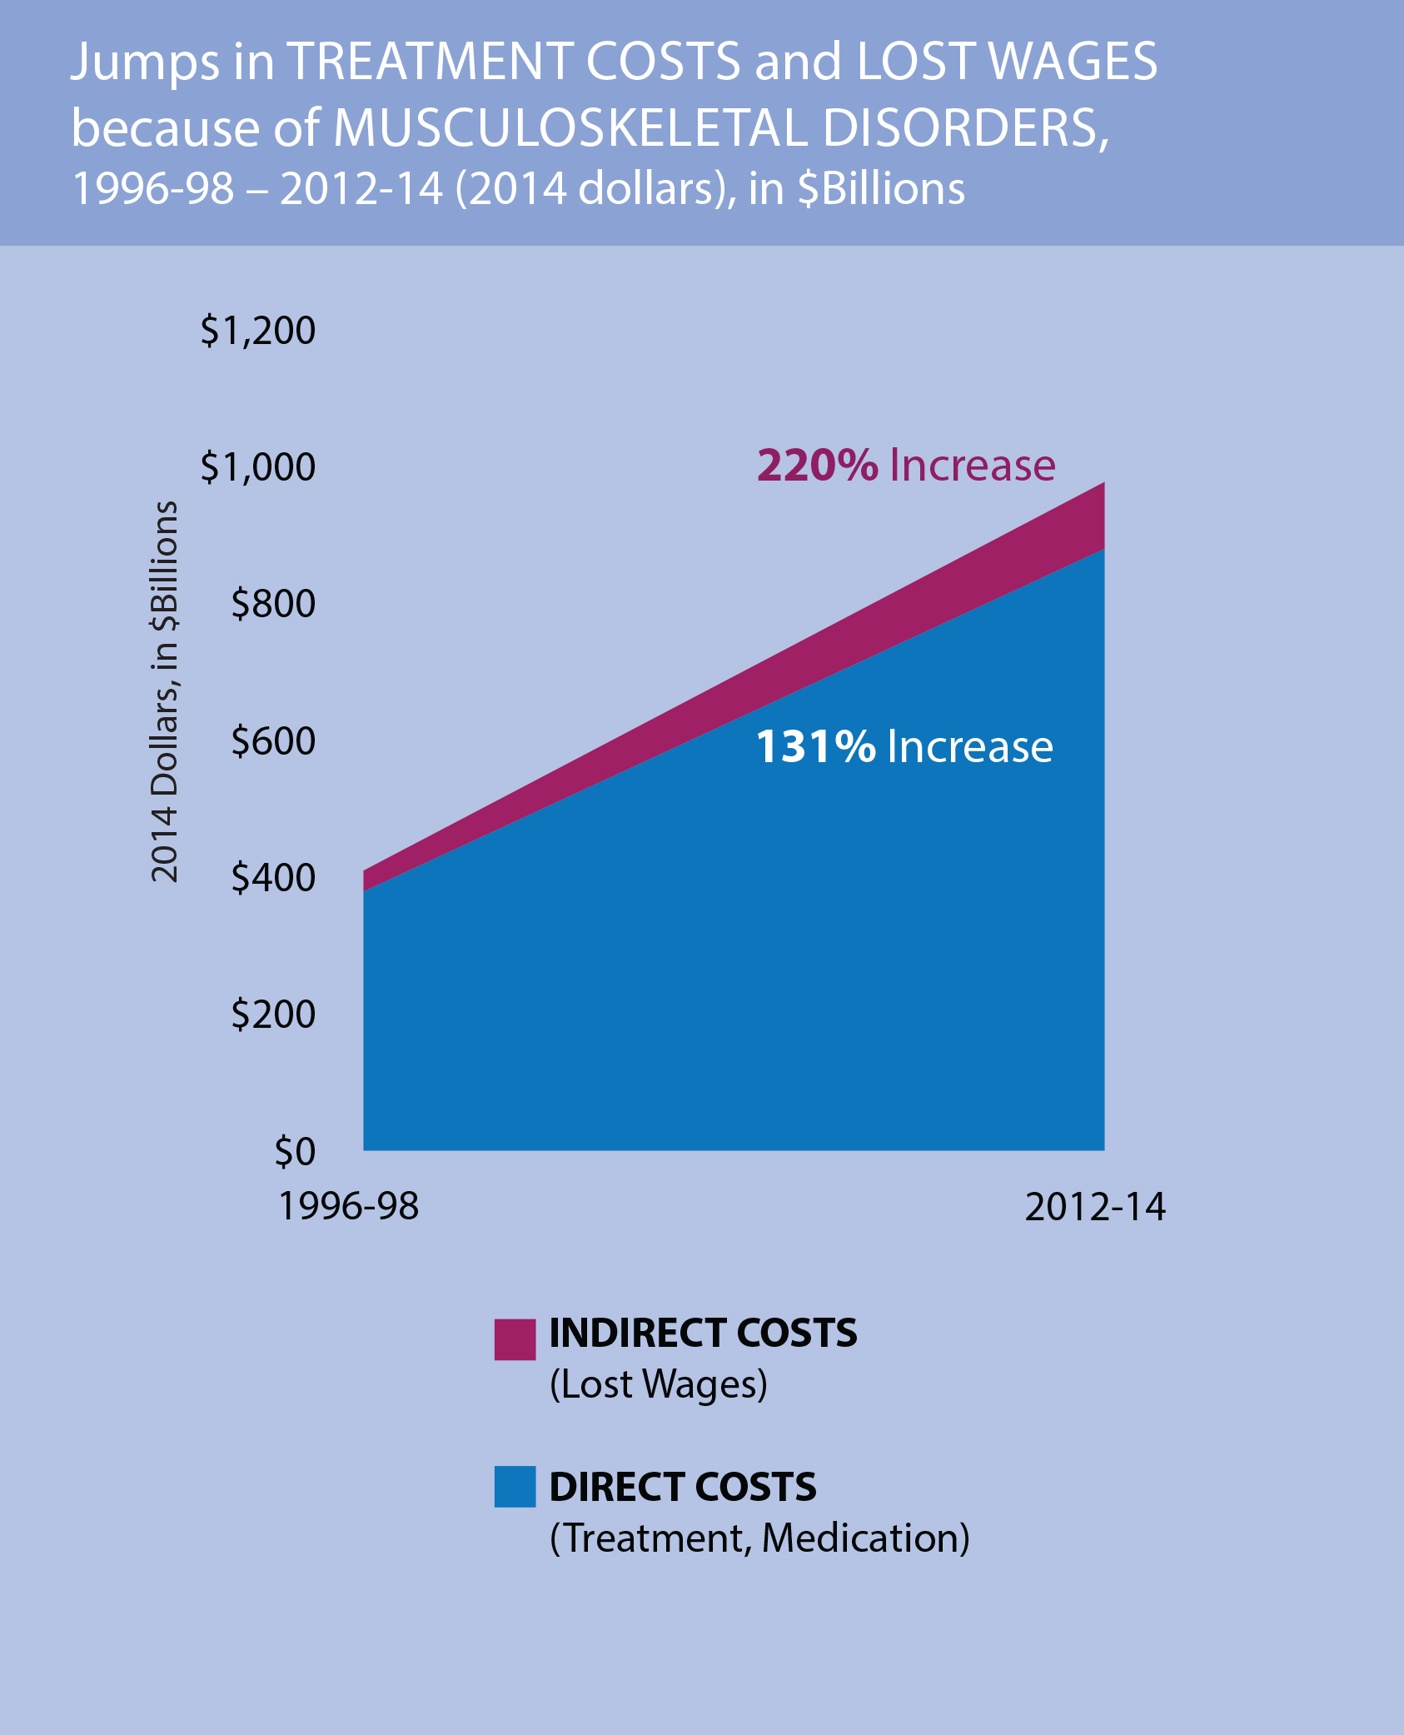
The Burden of Musculoskeletal Diseases in the United States cont.
The combination of a growing and aging population ensures that these costs will increase, unless current trends are reversed.
Sources:
http://www.boneandjointburden.org/
Notes:
DIRECT COSTS are the costs within the healthcare system, such as treatments provided in clinics and hospitals, including emergency departments, and the cost of prescription medications.
INDIRECT COSTS represent estimates of lost wages, since adults of working age (in the 18-64 age range) with musculoskeletal disorders miss work more and may earn less. Both types of costs have jumped significantly—so much so that they constitute a significant proportion of the US Gross Domestic Product (GDP). Between 1996 and 2014, the costs of musculoskeletal disorders represented increasing shares of GDP, from 3.44% of GDP in 1996 to 5.76% of GDP in 2014, exceeding defense spending for that year. In all of these categories—direct costs, indirect costs, and share of GDP—the economic impact of musculoskeletal disorders is increasing.

Slide 5
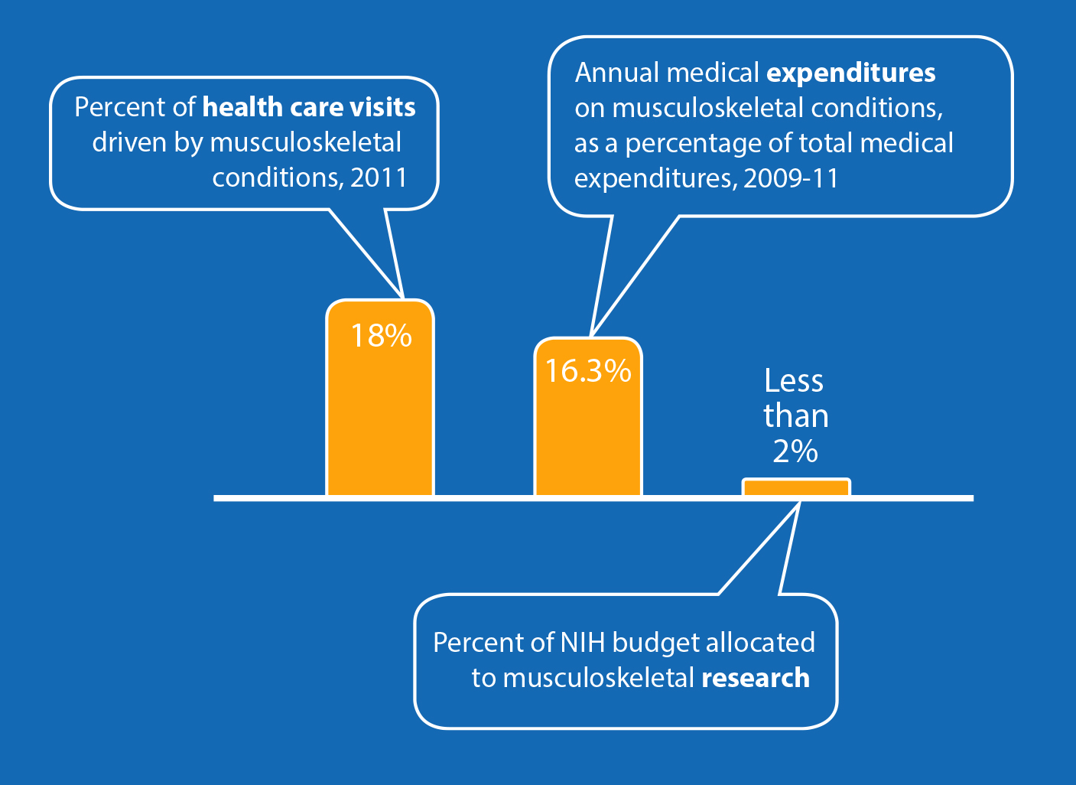
MSK Disorders Affect Everyone
Sources:
http://www.boneandjointburden.org/

Slide 6
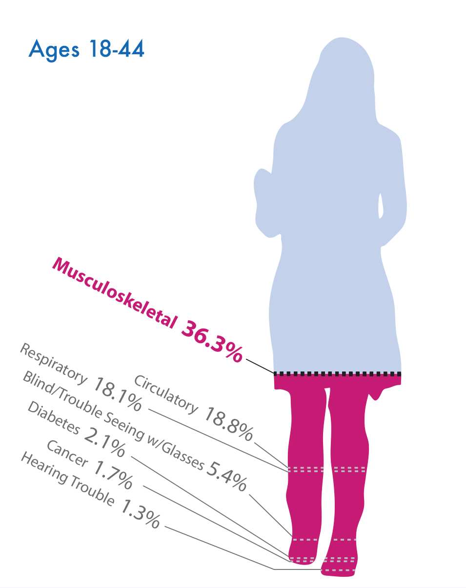
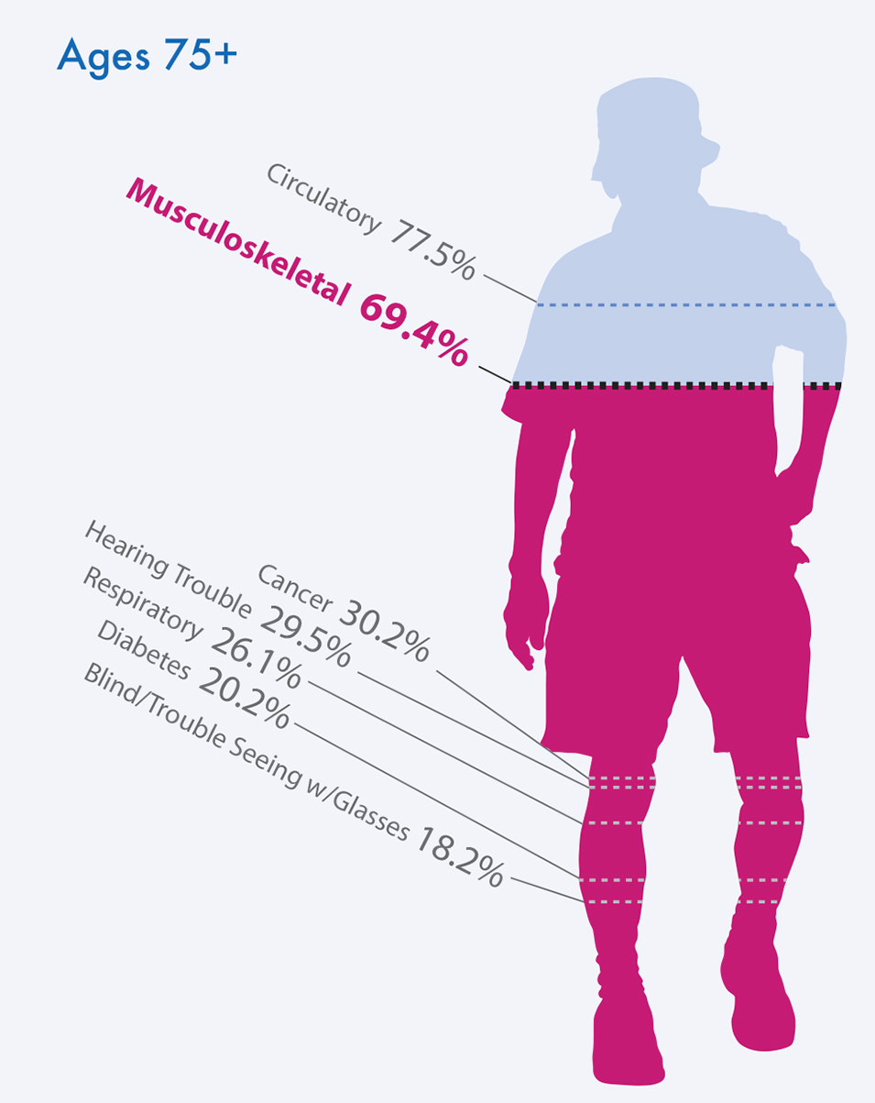
MSK Disorders Affect Everyone
Sources:
http://www.boneandjointburden.org/
Notes:
Not surprisingly, as people age, conditions such as hearing and vision problems, cancer, and heart disease become more common. Still, across all adult age categories, musculoskeletal conditions are either the most commonly reported medical conditions (among those under 65) or second most commonly reported (among those 65 and older).

Slide 7
Spine-related Disorders (SRDs)
Low back pain affects an estimated 80% of adults at some point during their lives
2012-2015 WHO data established that SRDs have become the No. 1 cause of disability in the world
SRDs are now the No. 3 most costly health condition in the US
In a given year, 12-14% of American adults will visit a physician due to back pain
Sources:
http://www.boneandjointburden.org/

Slide 8
Other Major MSK Disorders
Arthritis
Includes osteoarthritis (OA) and inflammatory arthritis
More than 1 in 4 adults have a doctor-diagnosed arthritis; by 2040, this could include ~78 million Americans
Challenges include access to care, patient adherence to treatment regimens (medication, lifestyle changes), and attention among both patients and clinicians to the role of evidence-based non-pharmacological interventions such as exercise and behavior modification.
Reimbursement models must create incentives for ongoing, long-term management of chronic diseases.
Injuries
While MSK injuries among workers have declined, they still account for >50% of all worker nonfatal injury cases that involve days away from work
Injuries also take a toll on athletes and members of the US military
Sources:
http://www.boneandjointburden.org/
Notes:
ARTHRITIS: Promising areas for research include the following:
What is most effective for pre- and post-operative pain management (especially non-opiate forms)?
Are there more effective ways to engage patients in treatments that are proven to effectively decrease OA morbidity, such as exercise and weight loss?
What is the role of systemic inflammation in the development of arthritis?
How can co-morbidities that often accompany arthritis be addressed and linked (e.g., weight loss, physical activity, nutrition counseling, behavioral health)?
What prehabilitation lifestyle/exercise regimen is best, prior to a joint replacement?

Slide 9
Other Major MSK Disorders
Osteoporosis
By 2030, nearly 14 million Americans will have osteoporosis-–low bone mass and strength that increases the risk of fractures and subsequent morbidity and mortality. Those with low bone mass, a potential precursor, will include close to 58 million.
The need for new drugs and therapies and changes to overall care are vital as our population ages.
Pediatric Conditions
An important research gap is measuring the burden of MSK conditions in young and active patients, and pediatric populations.
Sources:
http://www.boneandjointburden.org/
Notes:
OSTEOPOROSIS
One treatment care example is the Fracture Liaison Service (FLS) model for coordinated care among primary care, orthopaedic, emergency department providers, and other specialists, which tracks patients through a registry and allows for more consistent post-fracture assessments and follow-ups.
PEDS
As pediatric patients transition through adolescence into adulthood, they are often lost to follow-up, making it difficult to understand adult manifestations of pediatric musculoskeletal conditions. Better long-term follow-up data on pediatric musculoskeletal conditions would address this knowledge gap.

Slide 10
USBJI
The United States Bone and Joint Initiative (USBJI) is a multi-disciplinary initiative focused on MSK conditions
The USBJI is the US arm of the Global Alliance for Musculoskeletal Health (G-MUSC)—previously the Bone and Joint Decade—which is endorsed by 63 national governments and more than 750 patient advocacy and health professional organizations
Four primary values
Raising awareness and educating the world on the growing impact of MSK pathology
Empowering patients to participate in the decision-making process of their care and treatment
Increasing global funding for prevention activities and treatment research
Seek and promote cost-effective prevention and treatment of MSK injuries and disorders
Sources:
http://www.usbji.org/

Slide 11
Further Learning
Global Alliance for MSK Health - http://bjdonline.org/
The Burden of Musculoskeletal Diseases in the United States: http://www.boneandjointburden.org/
United States Bone and Joint Initiative (USBJI): https://www.usbji.org/
www.physiatrynow.org

